Slide 1
Tic-Tac-toe in oop
Presented by hassan Farooq ahmad

Slide 2

Contents of Project
Here's a breakdown of the contents and their purposes within the project:
Introduction
Vision and Scope
Objectives
Implementation Tools
Output Screen

Slide 3
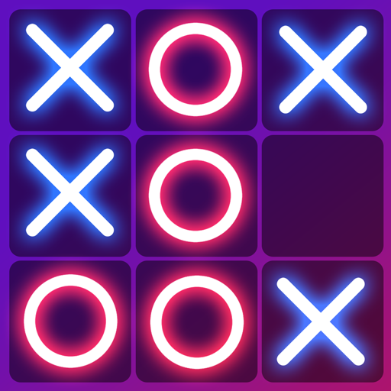
IntroDuction
The tic tac toe game project in C++ is a console-based application that revitalizes the classic game of tic tac toe, where players strategically place their marks, 'X' or 'O', on a 3x3 grid. The objective is to align three of one's own marks either horizontally, vertically, or diagonally, securing victory over the opponent. This project offers two gameplay modes: single-player versus a computer opponent and two-player mode for direct competition.

Slide 4
Vision and scope
The vision for the tic tac toe game project in C++ is to create a compelling and interactive digital version of the classic game, accessible via a console application. This project aims to capture the essence of tic tac toe, a game known for its simplicity and strategic depth, and bring it to life in a modern programming environment. The goal is to develop a game that is not only fun and engaging but also serves as a practical demonstration of object-oriented programming (OOP) principles, showcasing how these principles can be applied to create complex and interactive software applications.

Slide 5

Objectives of Project
Create a user-friendly interface
Optimize performance
Expand the game features optionally
Multiplayer functionality
Scoring system and leaderboards
Accessibility features
Cross-platform compatibility

Slide 6

Implementation Tools
DEV C++
MS Word
MS Power Point

Slide 7
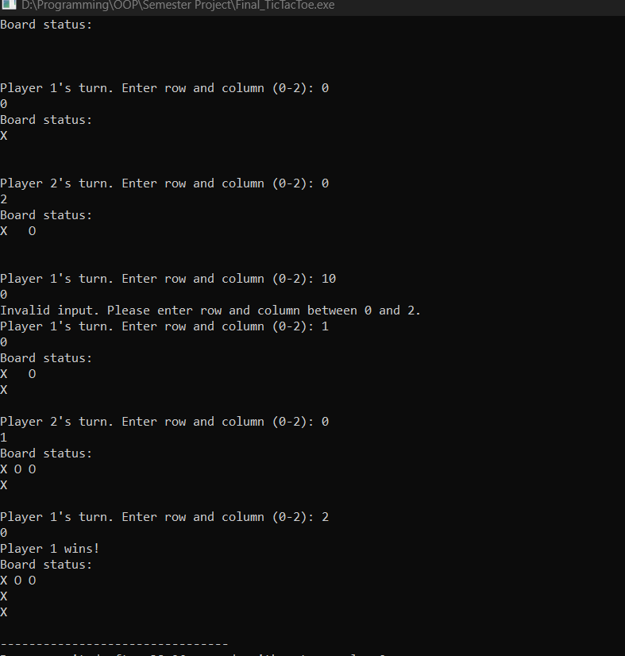

Slide 8
Program

Slide 9

Any queries?

Slide 10

Now it’s my turn

Slide 11
Thanks
.

